Slide 1
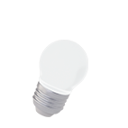
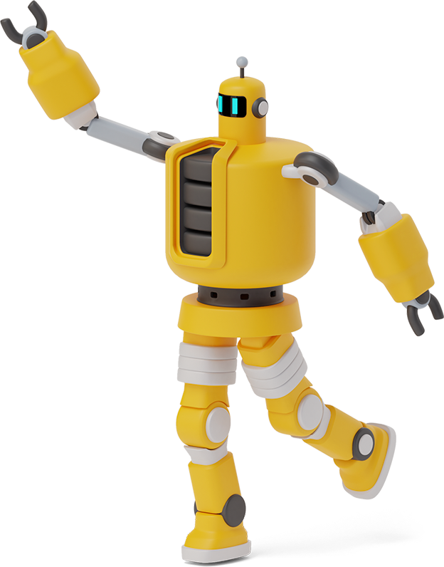
FOOD DELIVERY BOT
KIN LEUNG - TRUONG
Advisor: Dr. Naik
Notes:
Hi guys! My name is Kin Leung and this is my partner, Truong. Our advisor for this project is Dr. Naik. Today, we will be introducing to you guys our food delivery robot.

Slide 2
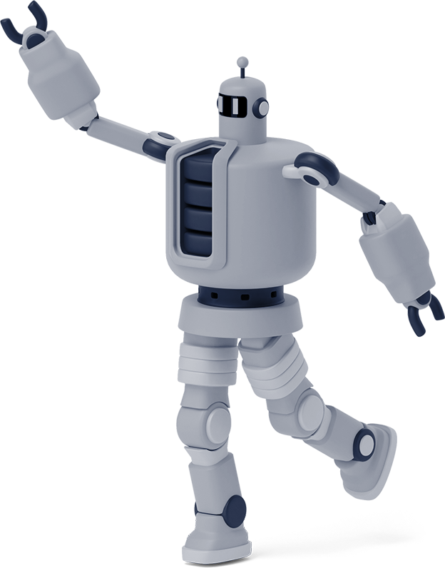

TABLE OF CONTENTS
1
BACKGROUND
5
GANTT CHART
2
OBJECTIVE
6
BUDGET
3
BLOCK DIAGRAM
7
CURRENT PROGRESS
REQUIREMENTS MATRIX
4
8
FUTURE WORK
Notes:
Our presentation will involve 8 parts: 1 2 3 4 5 6 7 8

Slide 3
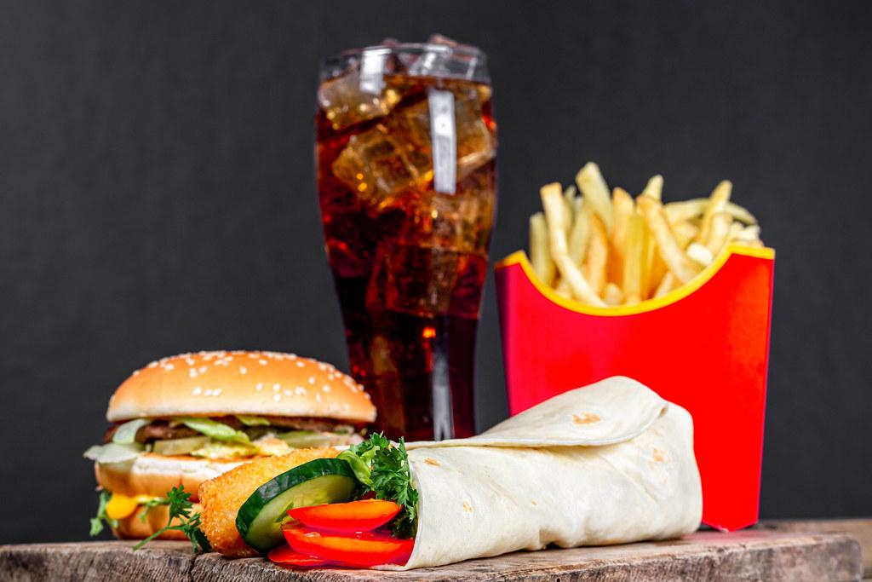
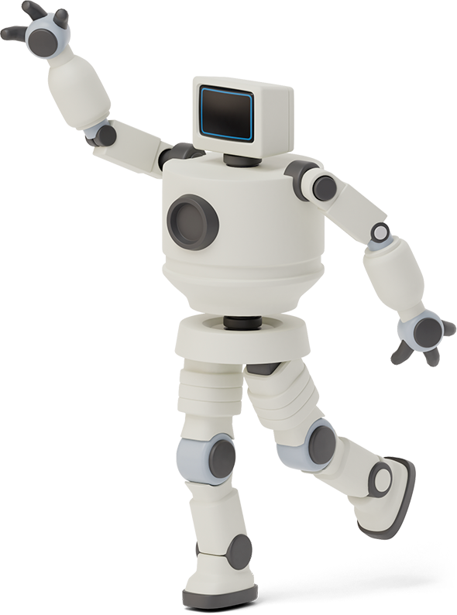

BACKGROUND

Slide 4

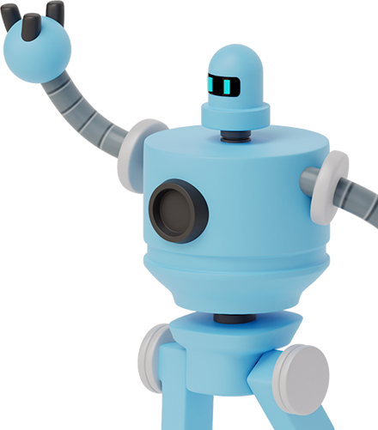
COVID-19, social distancing, restrictions, contactless communication.
Emergence of contactless delivery.
Facilitates human access to necessities.
Demand massively surged.
Existing solutions: Starship, Kiwibot, OzRobotics

Slide 5
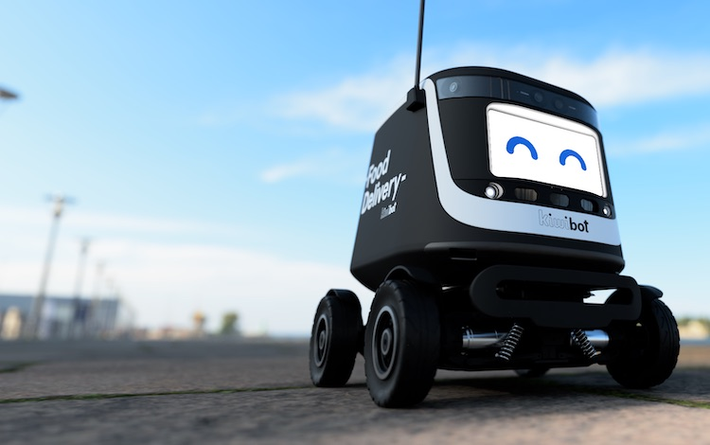
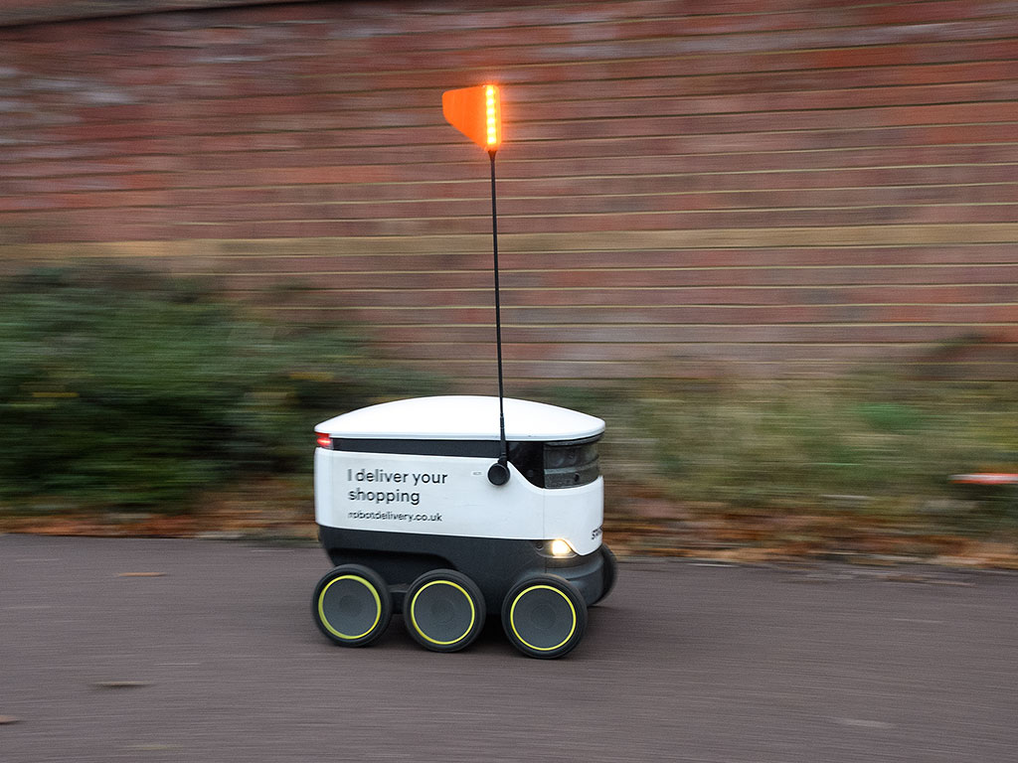
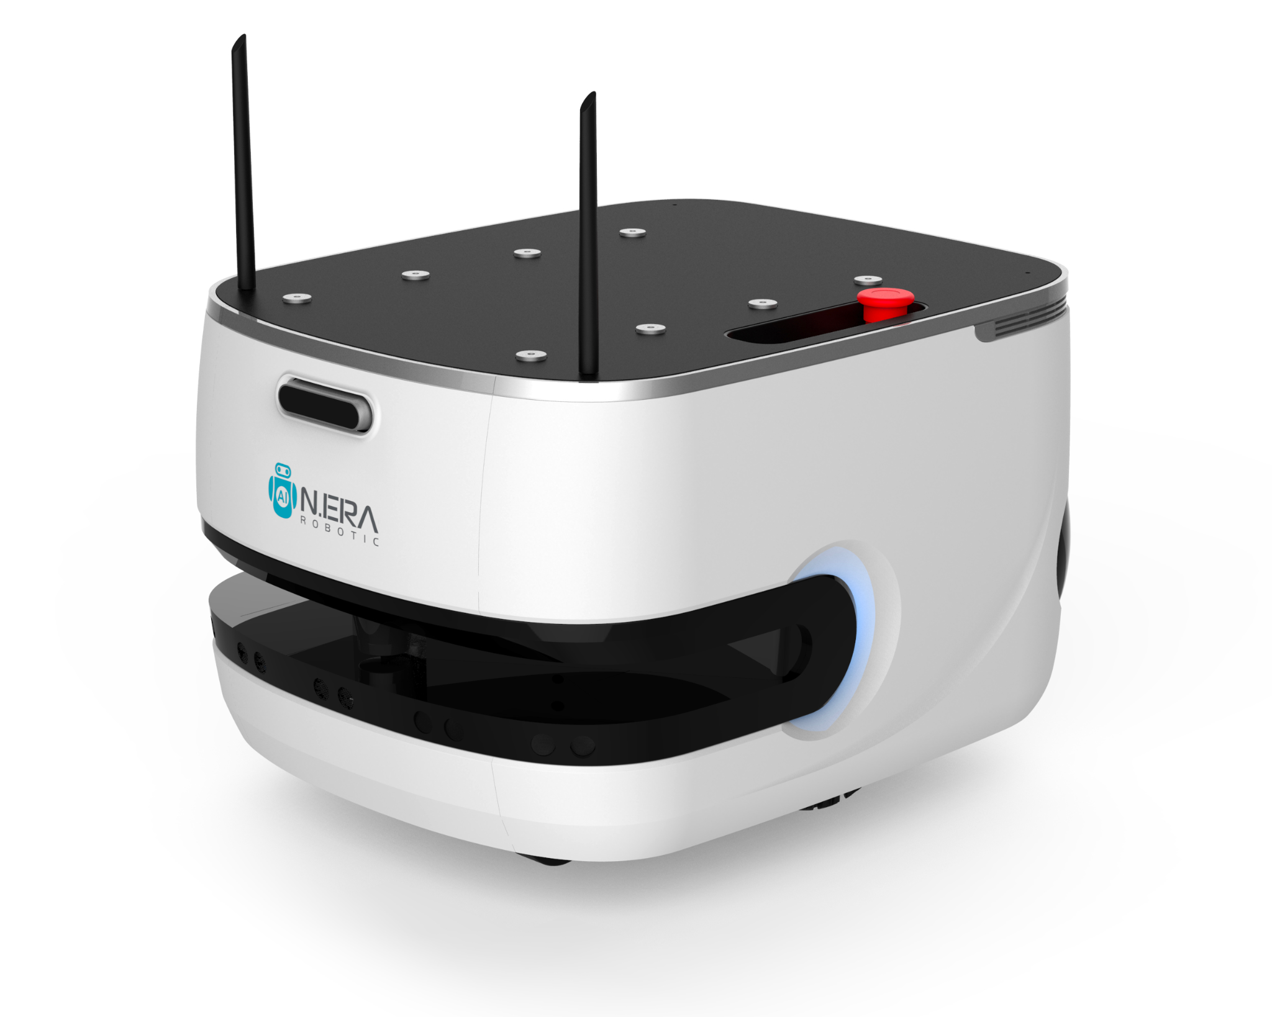

Slide 6

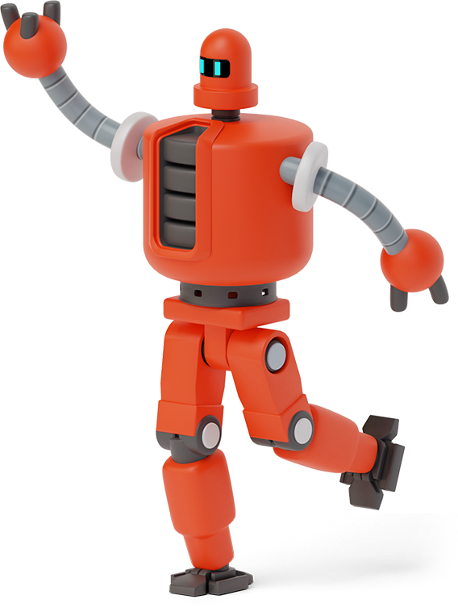
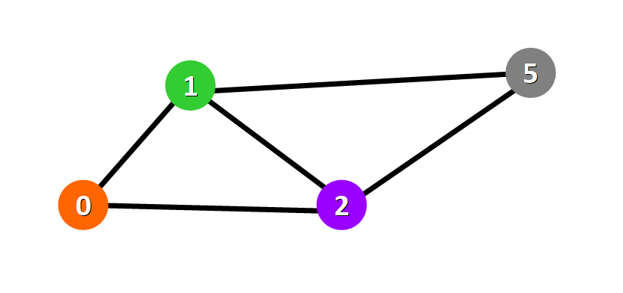
OBJECTIVEs

Slide 7
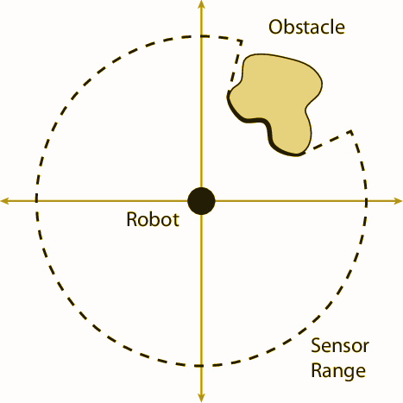
Autonomously move from starting point to destination vice versa.
Obstacles, steps, hole avoidance.
Keep food warm/cold.
Locatable and secured

Slide 8


BLOCK DIAGRAM

Slide 9
GPS
IR Sensor
PID Controller
Ultrasonic sensor (3)
Arduino Uno
Sensor Unit
Microcontroller
9V battery
Motor Driver
WIFI MODULE
Left Front Motor
Right Front Motor
Smartphone App
Left Back Motor
Right Back Motor

Slide 10
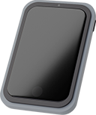
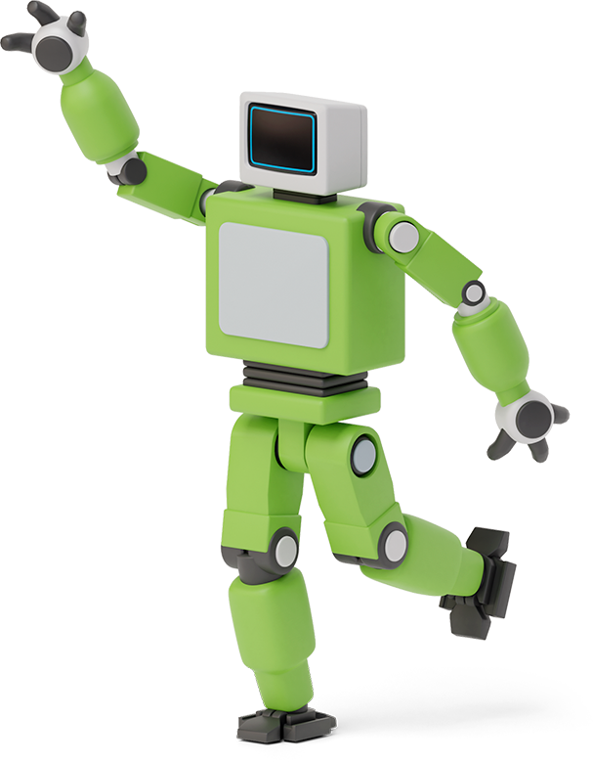

Requirements matrix

Slide 11
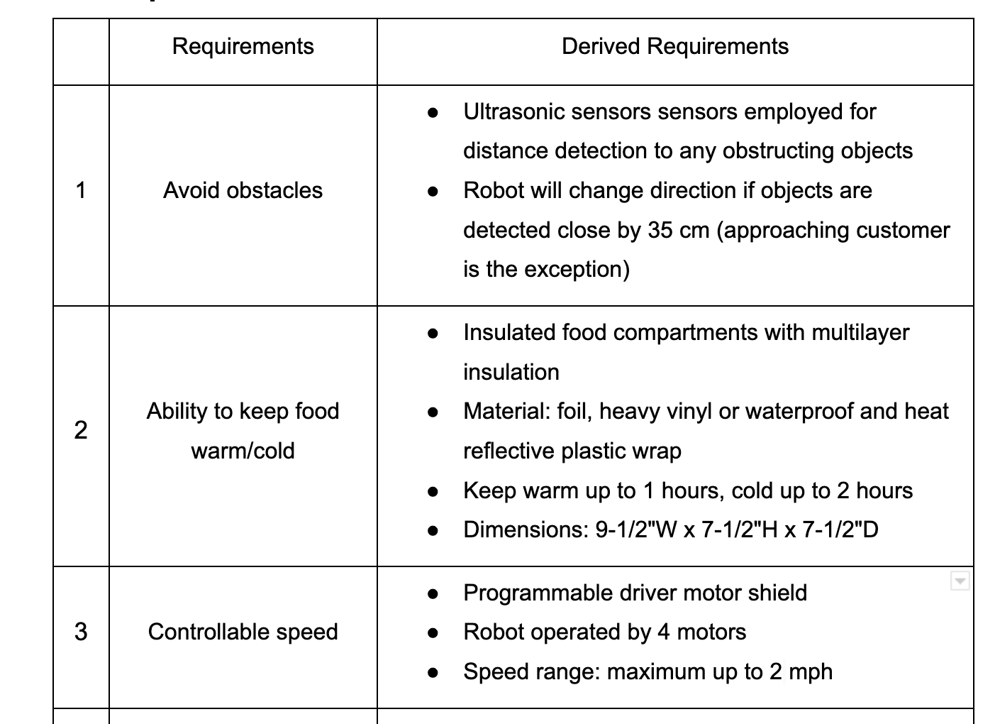

Slide 12
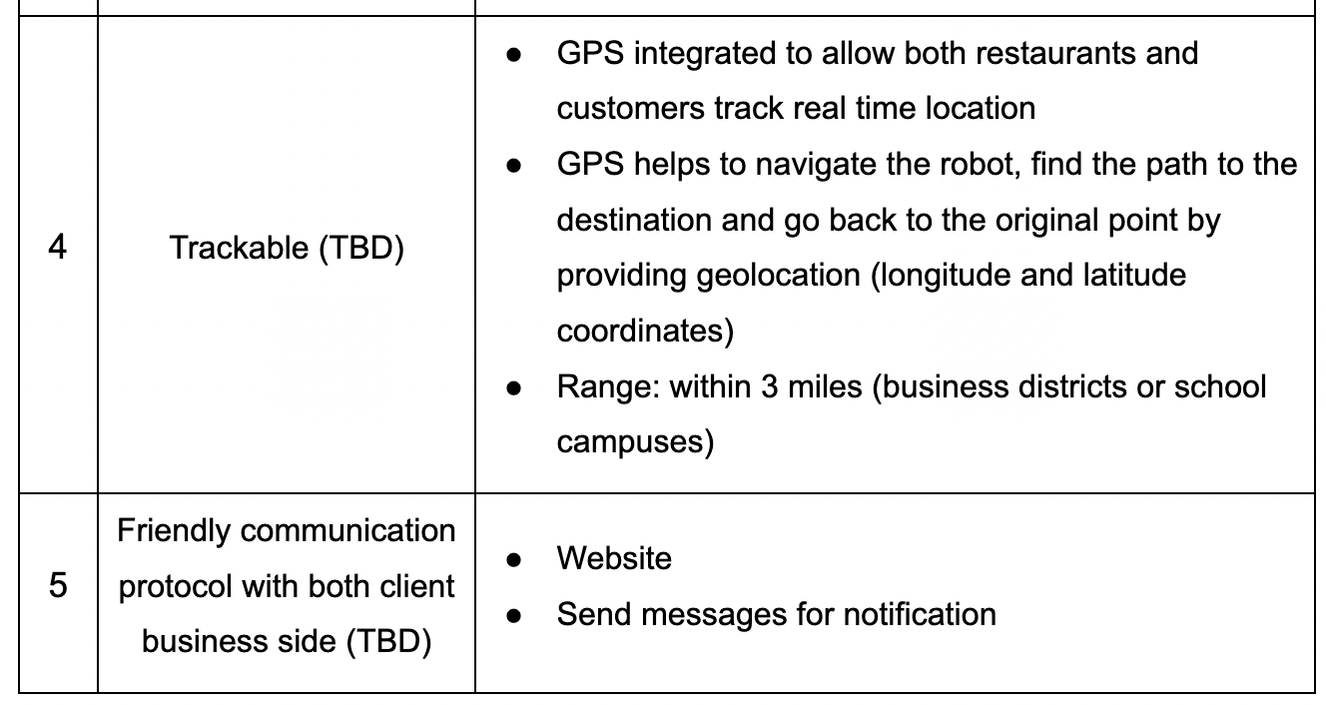

Slide 13

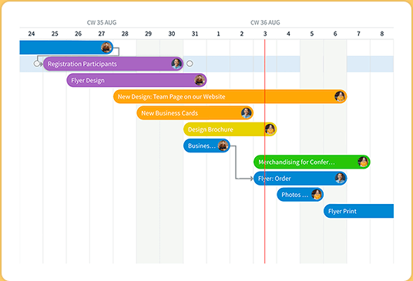
Gantt chart

Slide 14
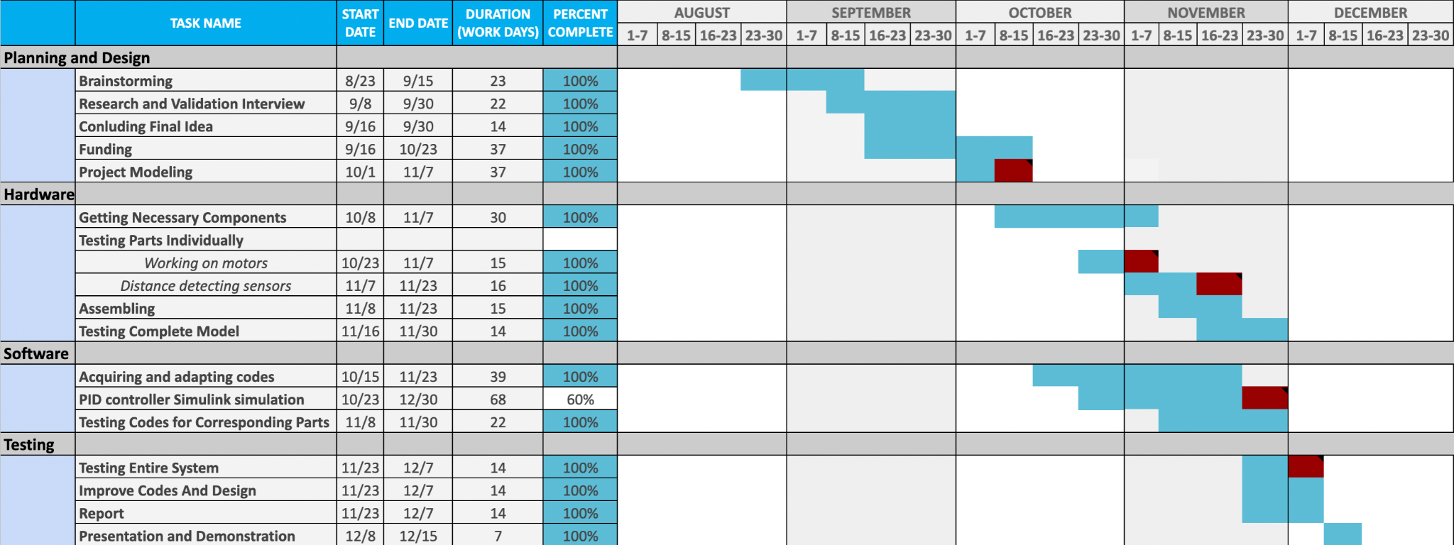
1. SSR Done
2. Moving Bot
3. Obstacle Avoiding
4. Partly Done PID
5. Prototype #1

Slide 15

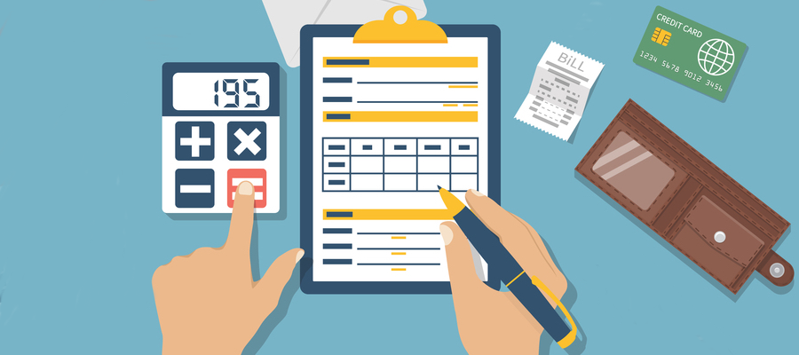
BUDGET

Slide 16
Key | Item | Amount | Cost per | Total cost
A | Ultrasonic sensor (Sensor Mount Included) | 3 | $2.40 | $7.20
B | DC Motor and Smart Car Wheel Compatible (Wires Included) | 1 KIT | $16.99 | $16.99
C | IR sensor | 2 | $0.83 | $1.66
D | Breadboard | 1 | $1.75 | $1.75
E | 9V Battery | 2 | $4.99 | $9.98
F | Microcontroller (ELEGOO UNO R3 ) | 1 | $13.99 | $13.99
Total |  |  |  | $51.57

Slide 17

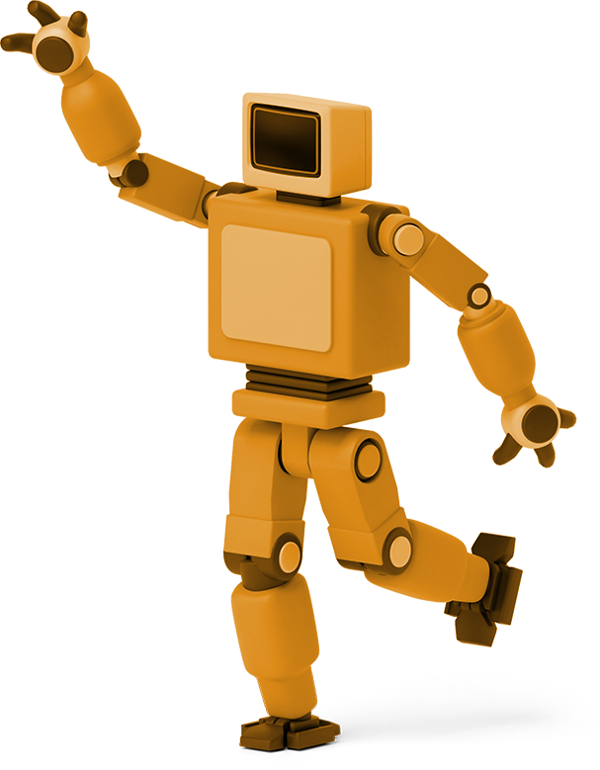
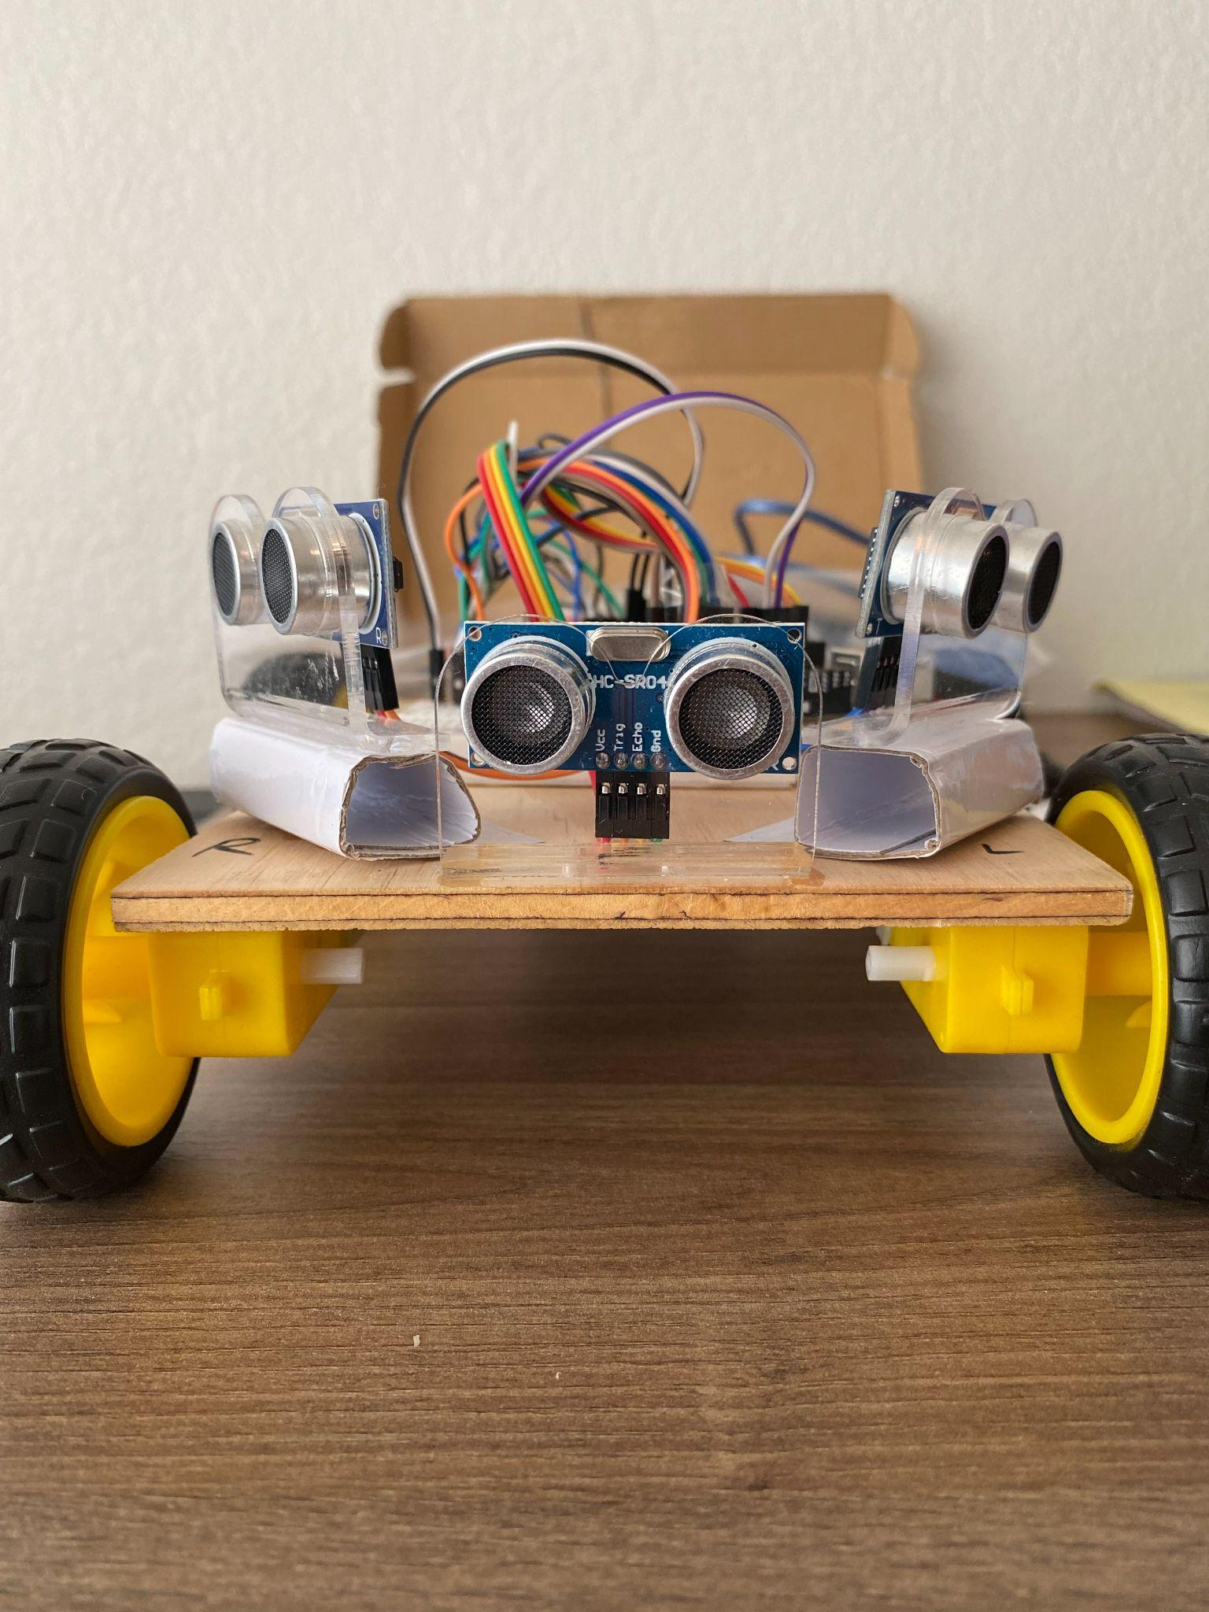
Current progress
Notes:
Let’s see what we have got so far.
I’m gonna begin with the PID simulation

Slide 18
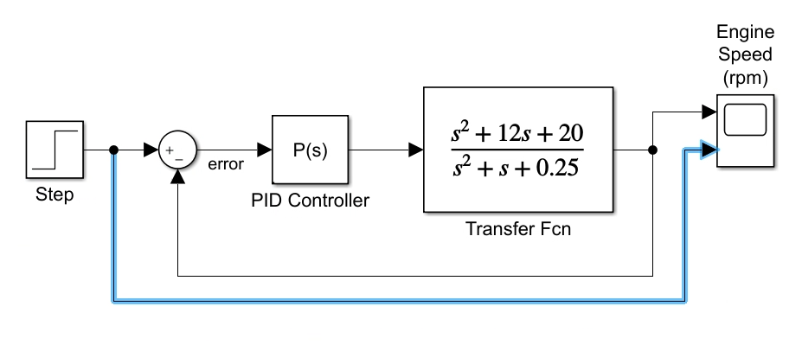
PID control simulation
Notes:
We do PID imulation because we need to know how can PID actually work on our robot.
PID controller can divide into P PID PI I-PD
This presentation will present P controller
Step function for see how the transfer function work
Decide the transfer function
As the denominator (pole) getting smaller, reaction will jump fast
Zero getting larger, reaction bounce back and become stable.

Slide 19
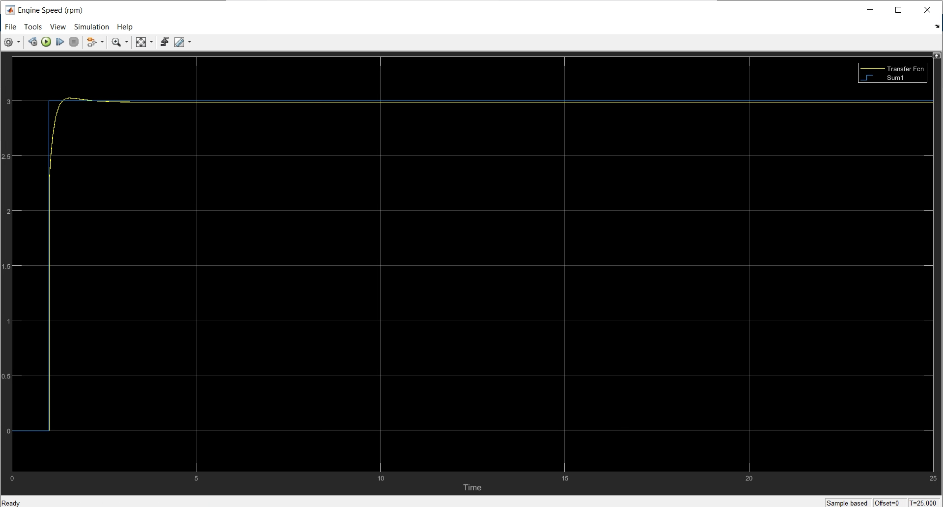
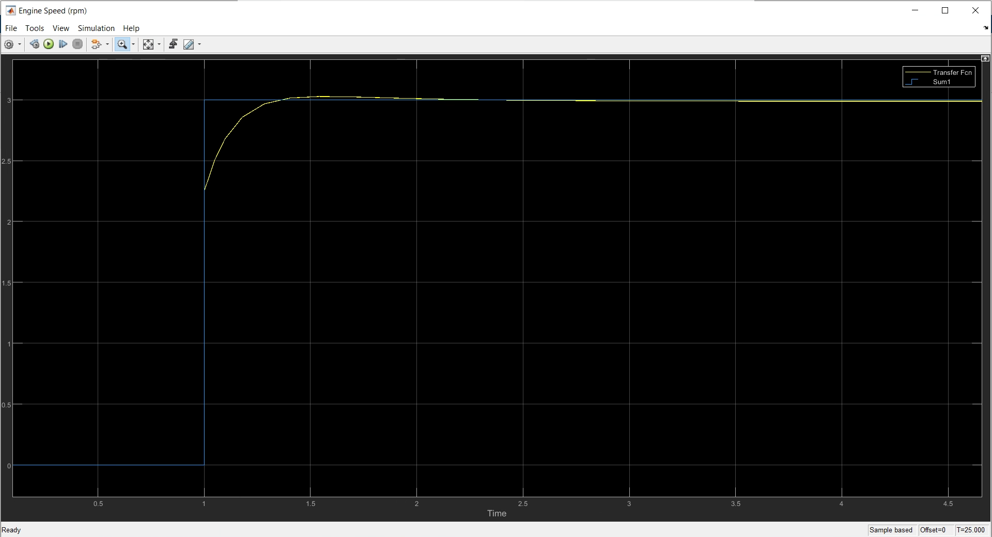
Notes:
The goal is to simulate the transfer function get close to the function we have. The less gap between yellow and blue, which mean less error happen, perfect performance

Slide 20
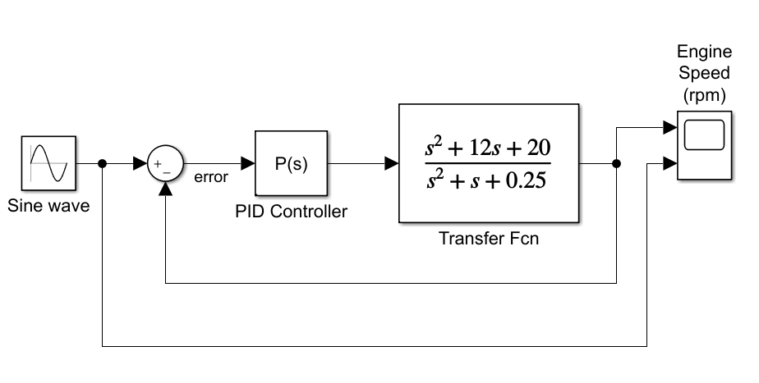
Notes:
Sine wave to replace step function
Using the same simulation

Slide 21
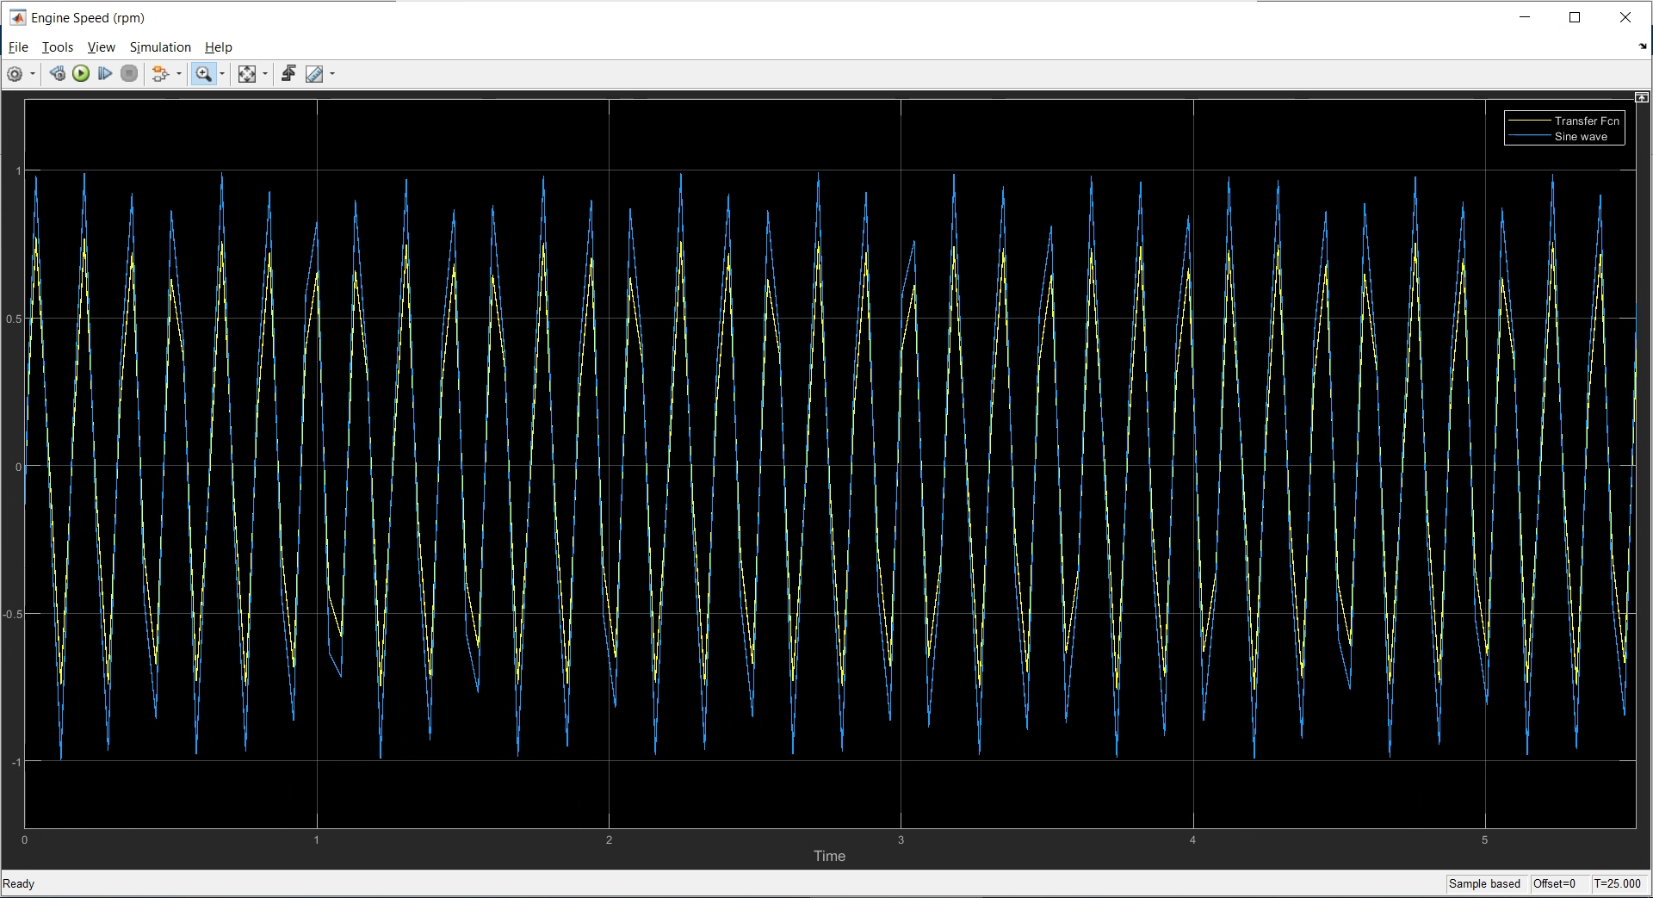
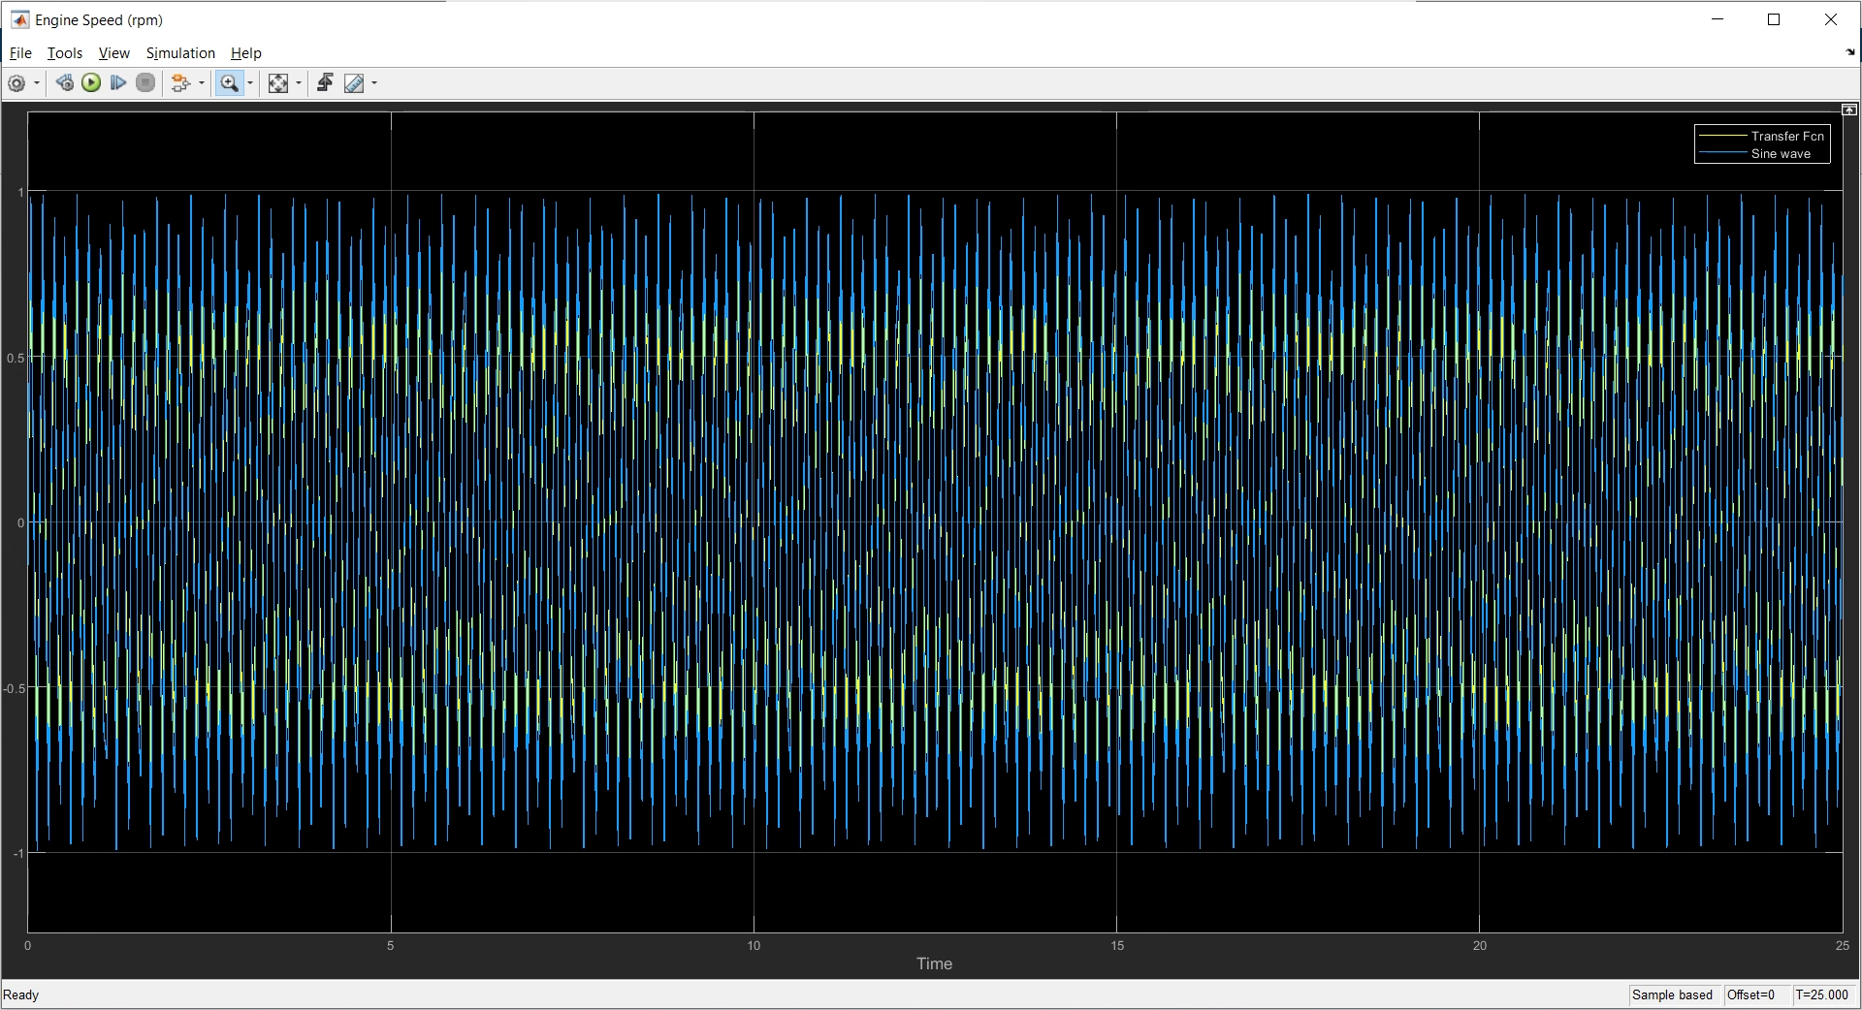
Notes:
Once the error is smal enough
Fit into the robot.
See will it be work the same as simulation.

Slide 22
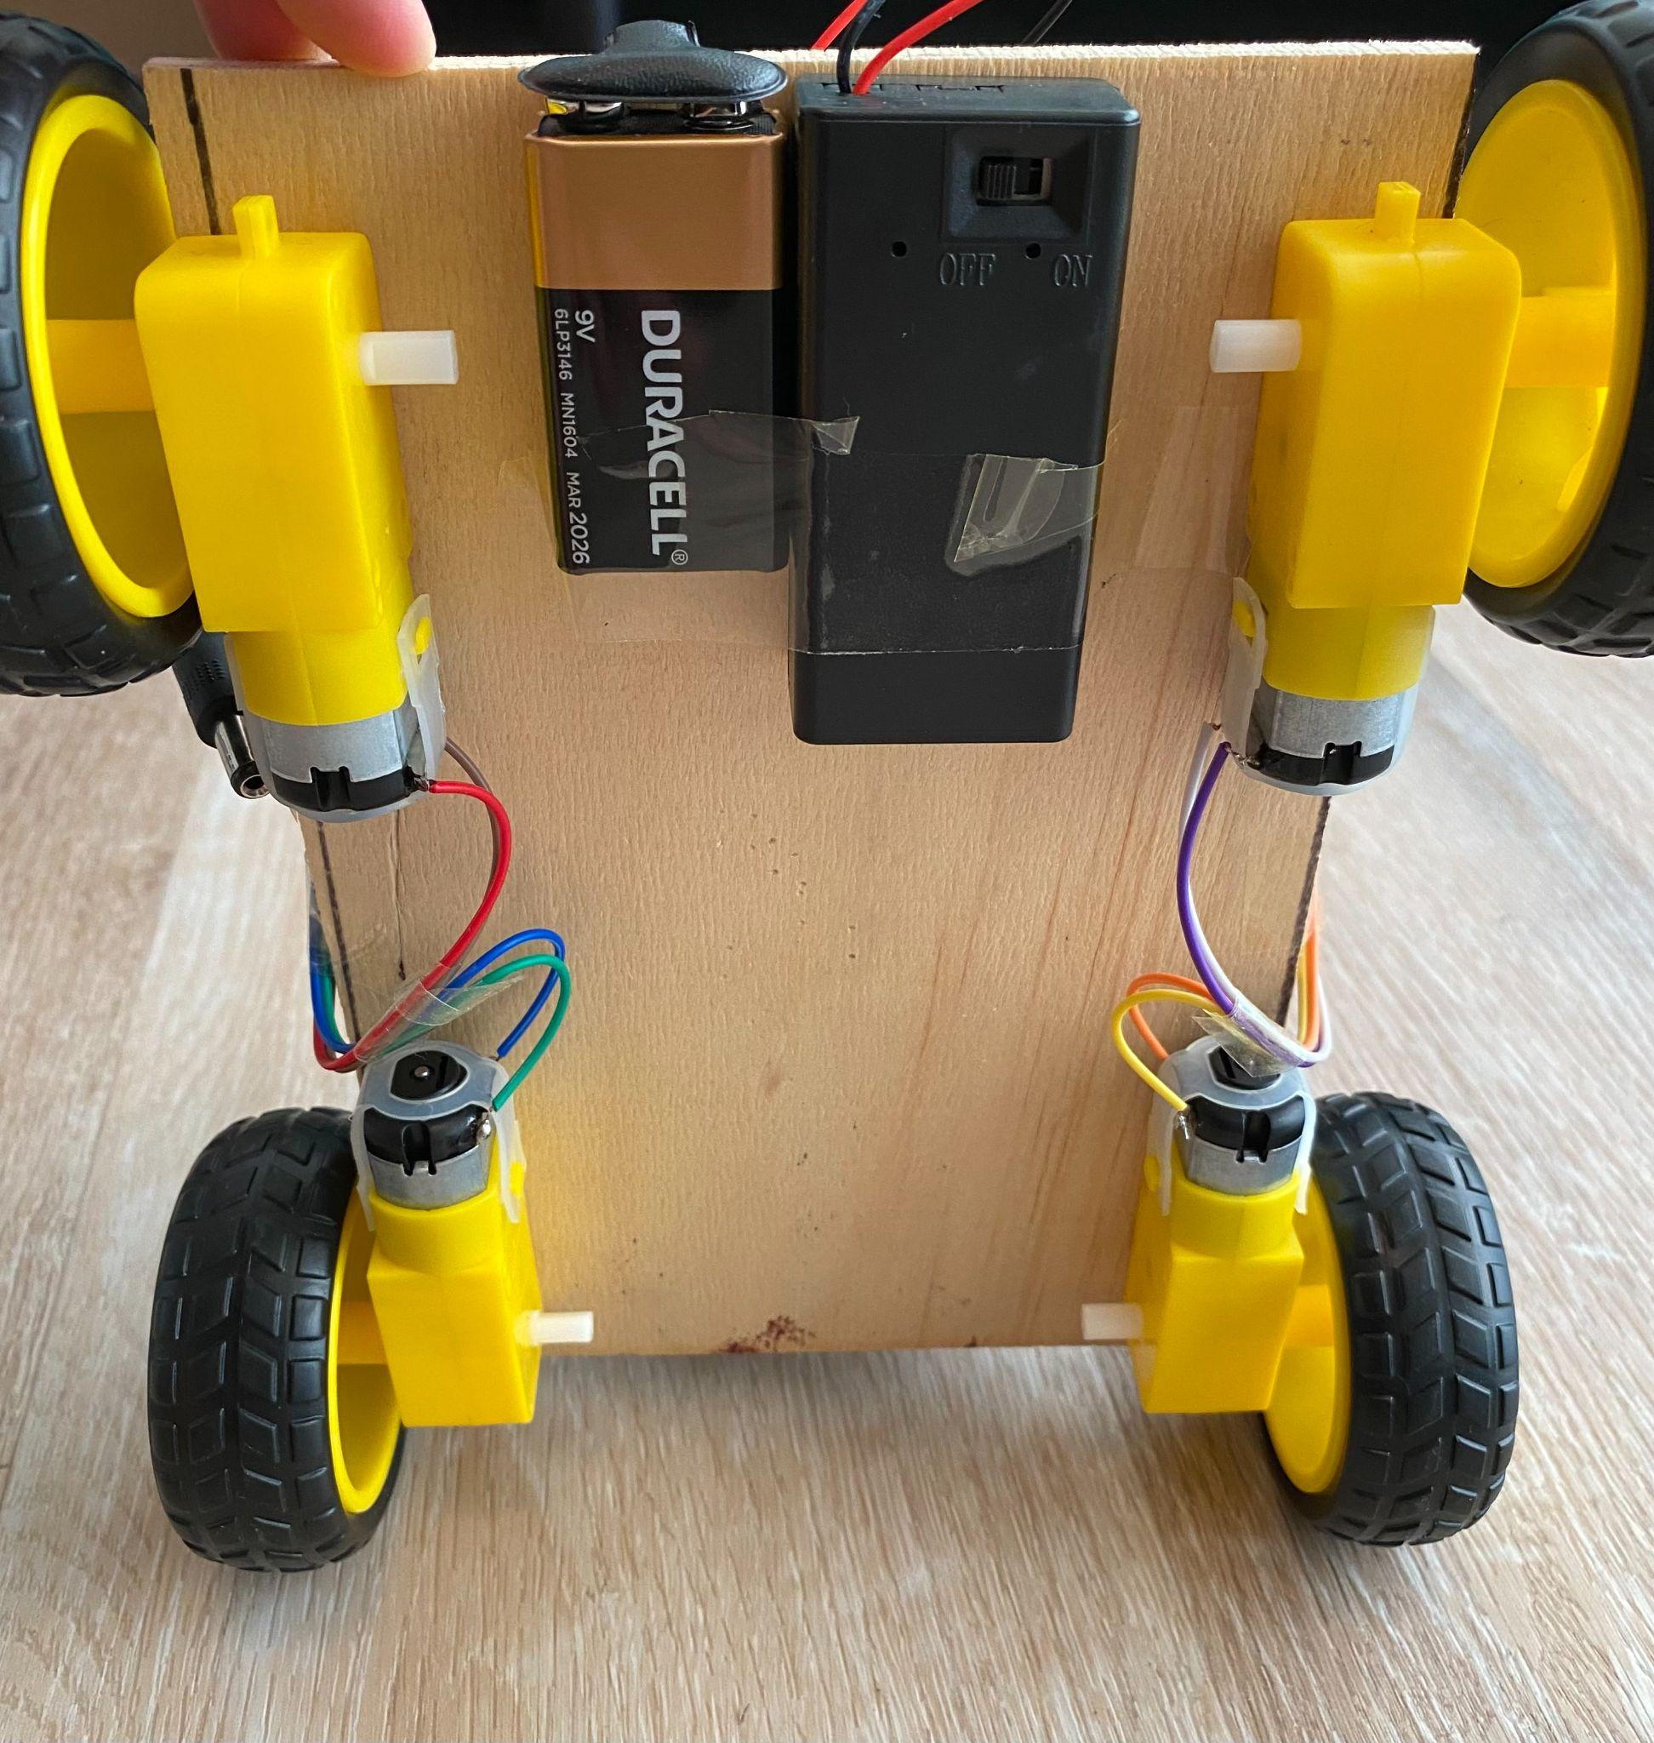
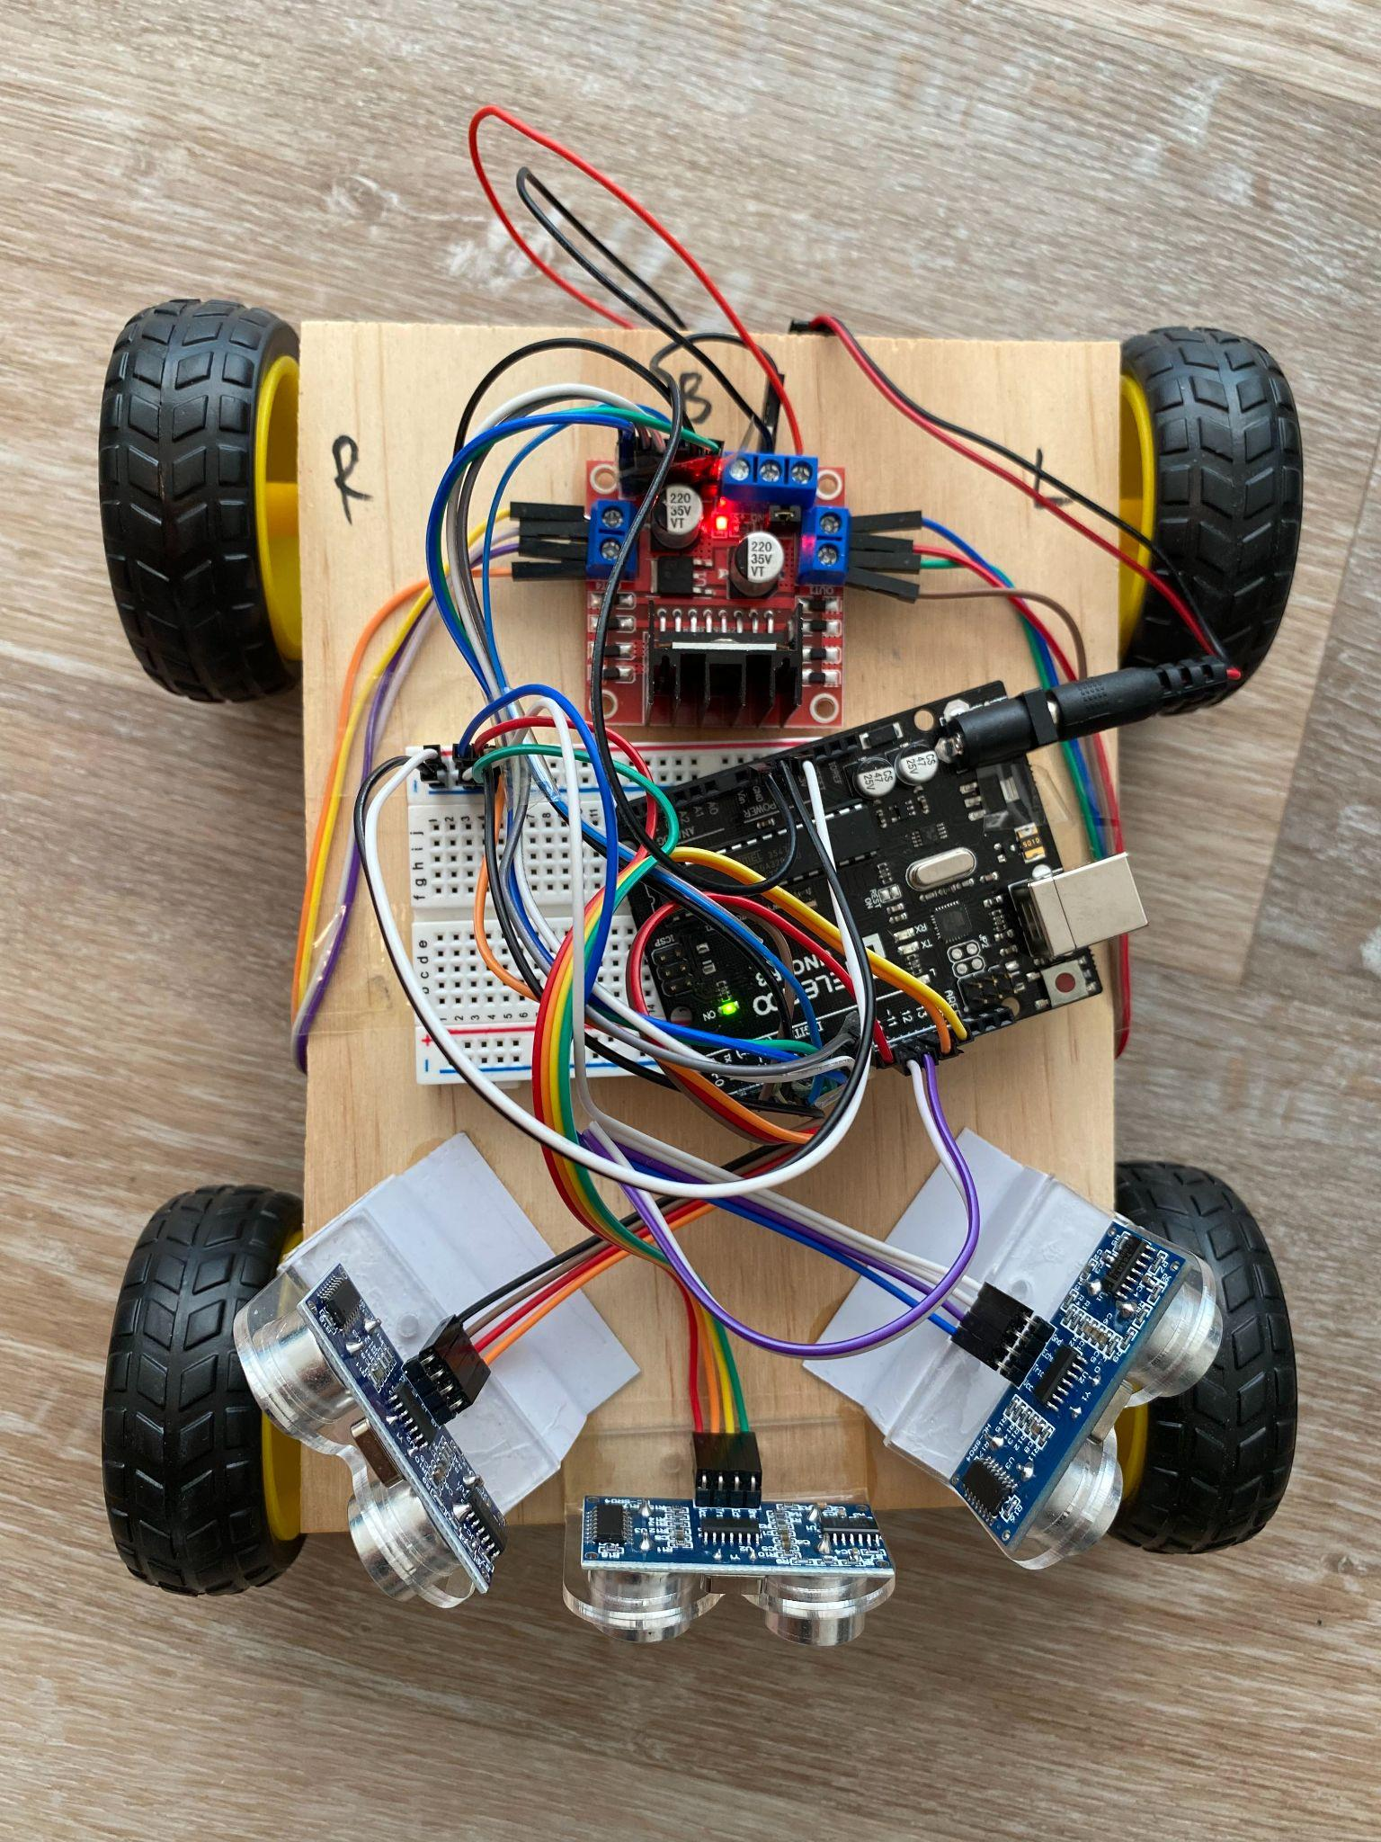
Approach
Have a switch to start/stop the bot
Initially moving forward while 3 sensors constantly sending data
When a specified distance detected, microcontroller sends control signals (HIGH/LOW) to the motor driver LN298H to control motors

Slide 23

progress
Move randomly
Turn left, turn right, move backward
Detect obstacles in front, left and right
Change direction when objects detected
Current speed: approx 1.2 mph

Slide 24
issues and solutions
Limited detection angle => More sensors
Beeping sound from the motor driver => Battery and connection checking
Motors stopped working => Replacing Battery
One of the Ultrasonic Sensors wasn’t sending data => Testing individually and changing pins number

Slide 25


Future work

Slide 26

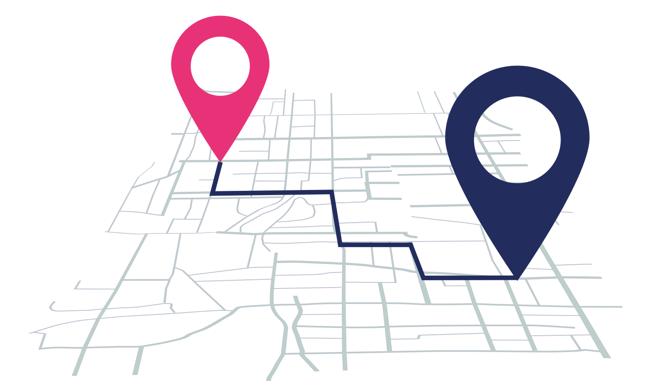

Integrate PID for Controlling Motors
Integrate GPS for Localization
Integrate Wifi to Enhance Communication
Improve Design
Path Planner
3D Printing

Slide 27
REferences
Facts & Factors. (2021, August 26). Autonomous delivery Robots market size & share value will REACH Usd 55 Bn BY 2026: Global report by facts & Factors. GlobeNewswire NewsRoom. https://www.globenewswire.com/news-release/2021/08/26/2287023/0/en/Autonomous-Delivery-Robots-Market-Size-Share-Value-Will-Reach-USD-55-Bn-by-2026-Global-Report-by-Facts-Factors.html.
Jennings, D., & Figliozzi, M. A. (n.d.). A study of Road autonomous delivery robots and
their potential impacts on Freight efficiency and travel. PDXScholar. Retrieved
September 10, 2021, from https://pdxscholar.library.pdx.edu/cengin_fac/549/.
Hawkins, A. J. (2021, July 7). Grubhub will Use RUSSIAN-MADE robots to deliver food on college campuses. The Verge. https://www.theverge.com/2021/7/7/22566652/grubhub-delivery-robot-yandex-college-campus-autonomous.
Marr, B. (2020, May 29). Demand for these autonomous delivery robots is skyrocketing during this pandemic. Forbes. https://www.forbes.com/sites/bernardmarr/2020/05/29/demand-for-these-autonomous-delivery-robots-is-skyrocketing-during-this-pandemic/?sh=736148d77f3c.

Slide 28
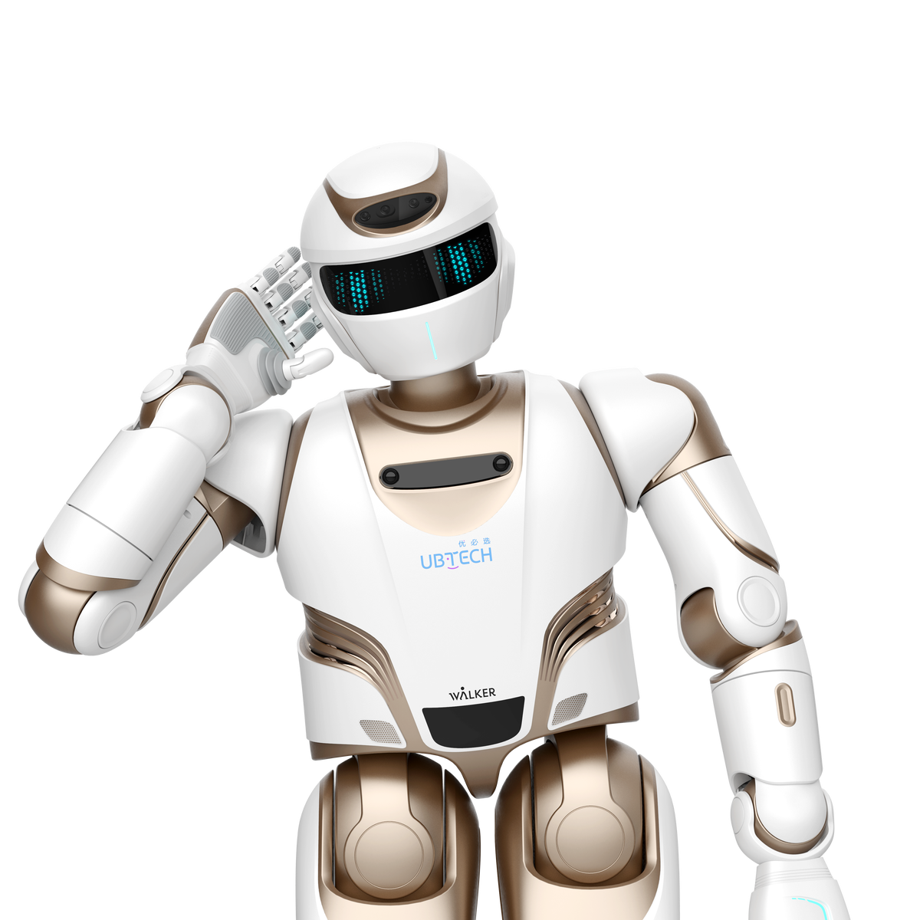
THANK YOU!
ANY QUESTION?

